Slide 1
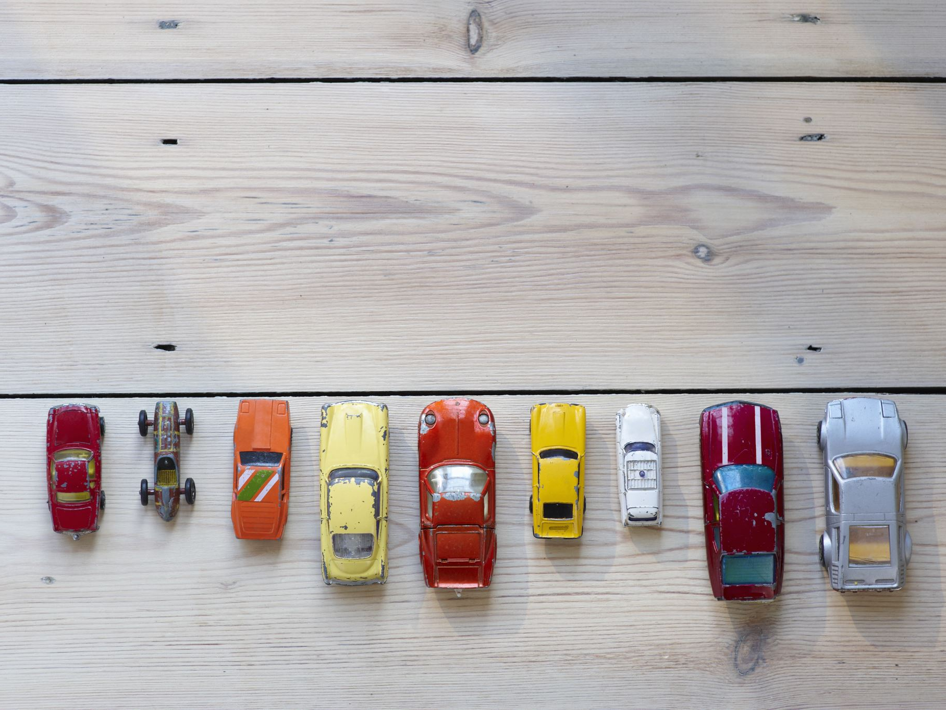
Used Car Price Prediction in Saudi Arabia with Machine Learning

Slide 2

Motivation
• Lack of transparent pricing in used car markets
• Public tools lag behind local market dynamics
• Need for reproducible, accurate models for valuation

Slide 3

Dataset Overview
• 5,482 used car listings from Saudi Arabia
• Attributes: brand, model, year, mileage, region, fuel type, gear, engine size
• Engineered features: vehicle age, price per km

Slide 4
Preprocessing & Feature Engineering
• Standardized string fields, removed invalid prices
• Bounded year and mileage to plausible values
• One-hot encoding for categoricals, scaled numerics

Slide 5

Model Comparison
• Linear models: Ridge, Lasso
• Non-linear models: Random Forest, XGBoost
• Unified sklearn pipelines for all models

Slide 6
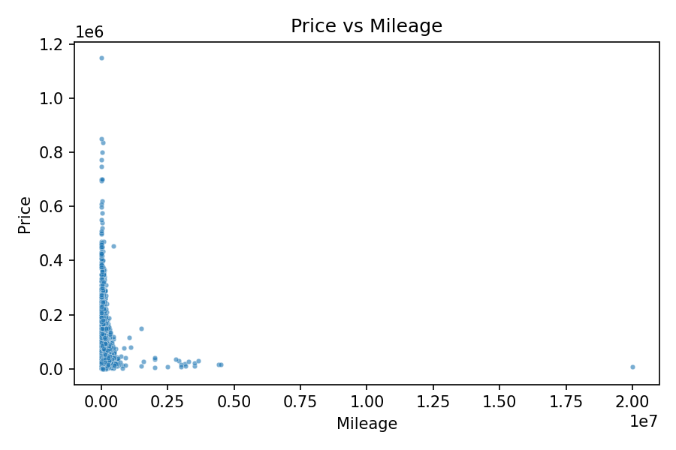
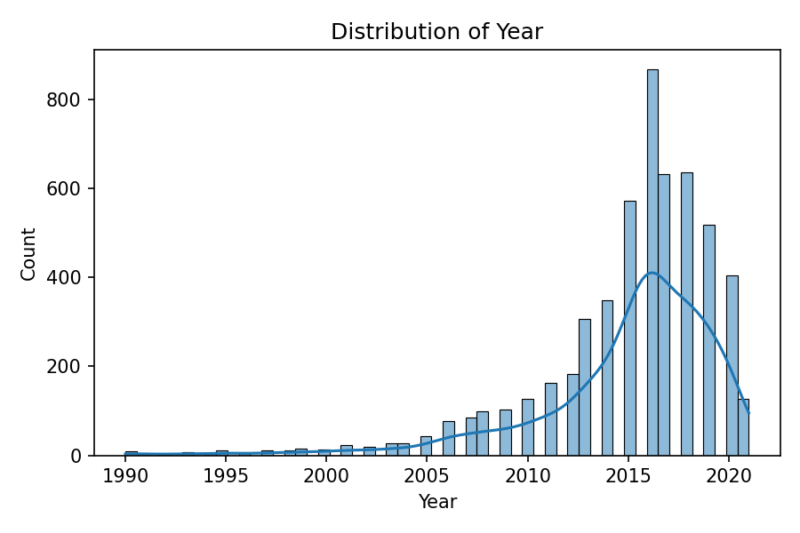
Figures

Slide 7
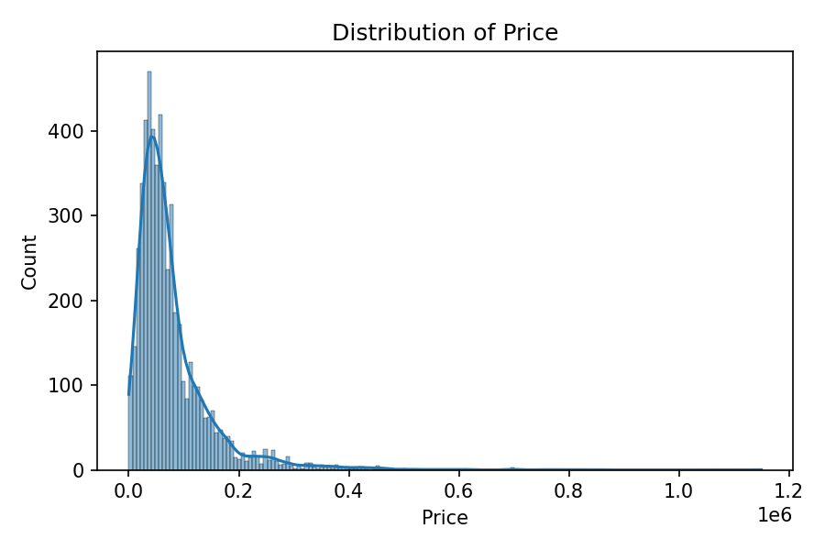
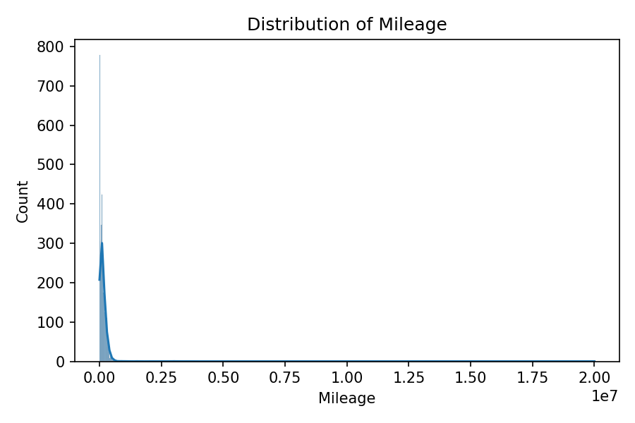
Figures

Slide 8
Evaluation Metrics
Model | RMSE | R²
Ridge | 40756 | 0.689
Lasso | 40833 | 0.688
Random Forest | 17172 | 0.945
XGBoost | 13728 | 0.965

Slide 9
Key Findings
• Mileage and vehicle age strongly influence price
• Brand and model type provide additional predictive power
• Non-linear effects critical – XGBoost outperforms

Slide 10
Visual Patterns
• Price distribution is right-skewed
• Negative correlation between mileage and price
• Robust transformations improve model performance

Slide 11
Interpretability
• Proposal to use SHAP values for explanations
• Quantify feature importance and fairness
• Compare effects across brands and regions

Slide 12

Practical Impact
• Simple, reproducible ML pipeline
• Easily transferable to other regional markets
• Scalable to full dataset (≈35,000 rows)

Slide 13

Technical Summary
• Tools: Python 3.12, pandas, sklearn, XGBoost
• Organized pipelines, joblib for model management
• Reproducible scripts and structured codebase

Slide 14
Conclusion
• ML ensures fairer pricing in used car markets
• XGBoost provides top accuracy and insights
• Lays groundwork for data-driven valuation systems

Slide 15
Thank you for your attention!

